Slide 1
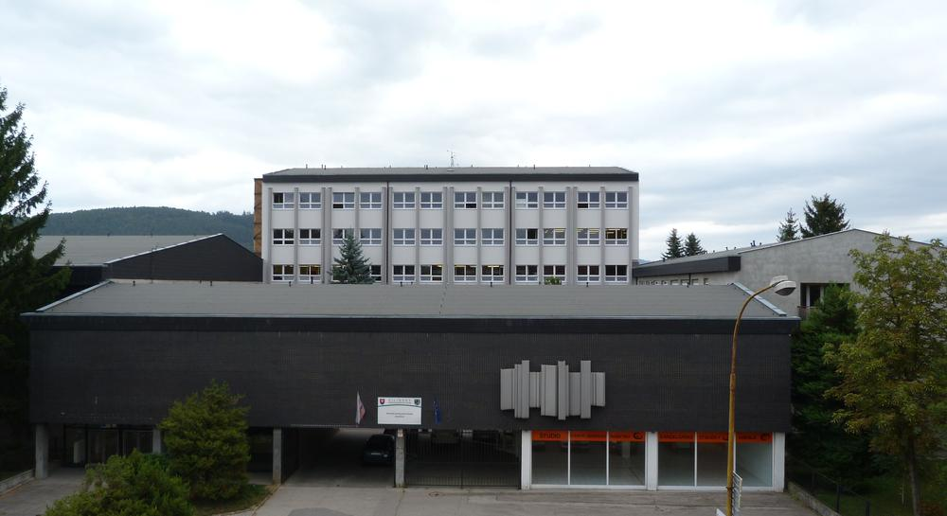
Slovensko – Žilina – SPŠ stavebná

Slide 2
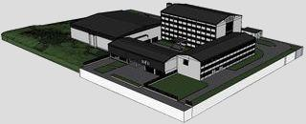
Stredná priemyselná škola stavebná Žilina Secondary Technical School of Civil Engineering in Žilina

Slide 3
Field of study for school year 2018/2019
Civil engineering
Technical and informatics services
Land surveying

Slide 4
Field of study 3650 M Engineering
Vocational subjects:
Descriptive geometry
Civil engineering
Building materials
Technical drawing
CAD systems
Constructions practice
1. year
After second year...
Vocational subjects Building mechanics
Civil engineering
Buildings constructions
Interior design
CAD systems
Constructions practice
Practice
2. year

Slide 5
Field of study 3650 M Engineering
After second year students can choose optional subjects with focus on :
Building constructions
Management in civil engineering
Fire prevention
Reconstructions
Road constructions

Slide 6
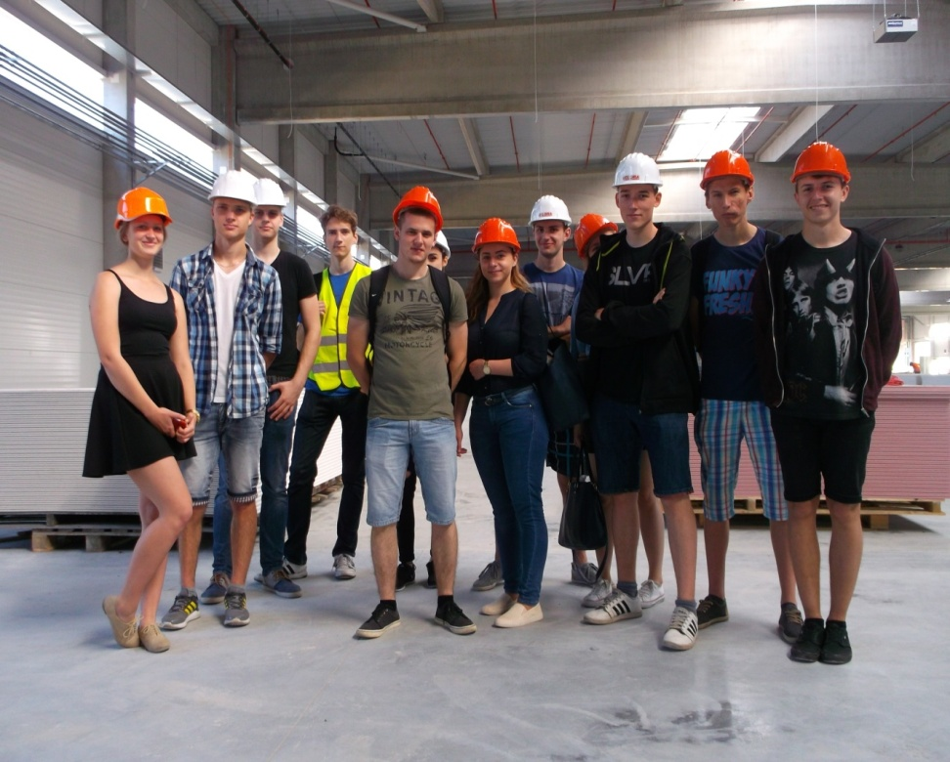
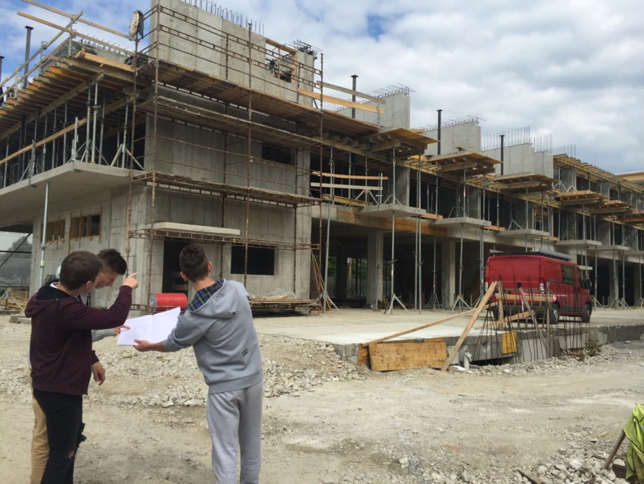
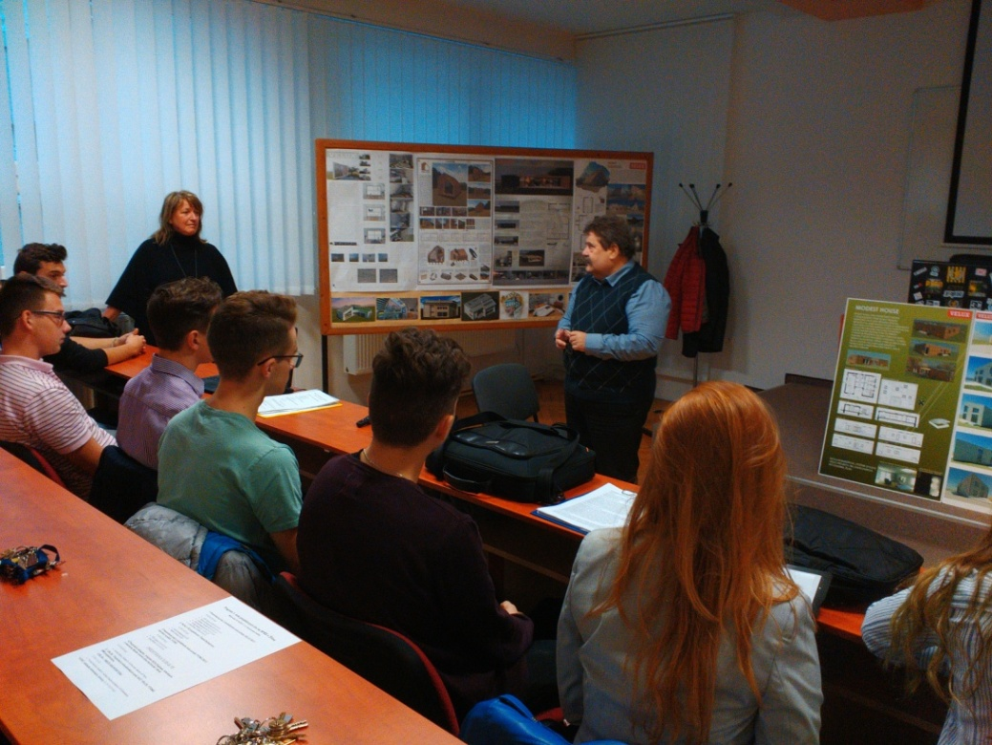
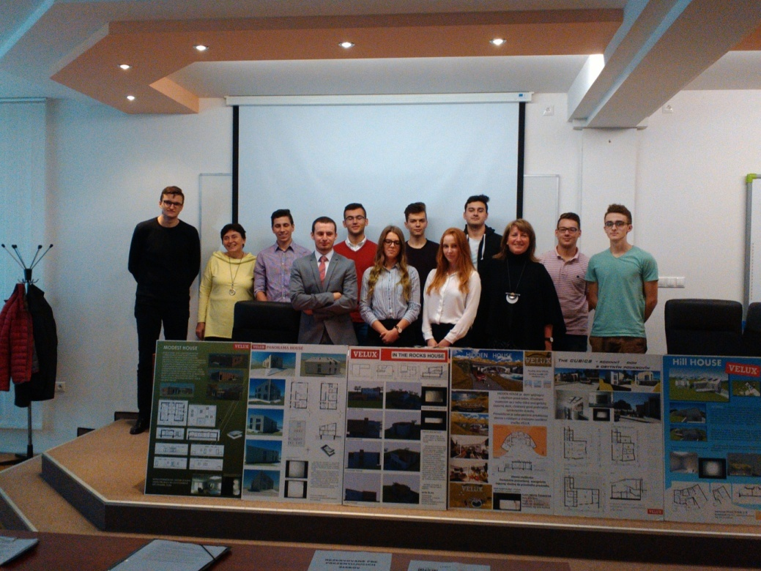
Field of study 3650 M Engineering
Civil engineering
3. and 4. year
Compulsory subjects :
Civil engineering, Statics, Economics, Land surveying, Thermo physics, Budgeting, Constructions practice, CAD systems,..

Slide 7
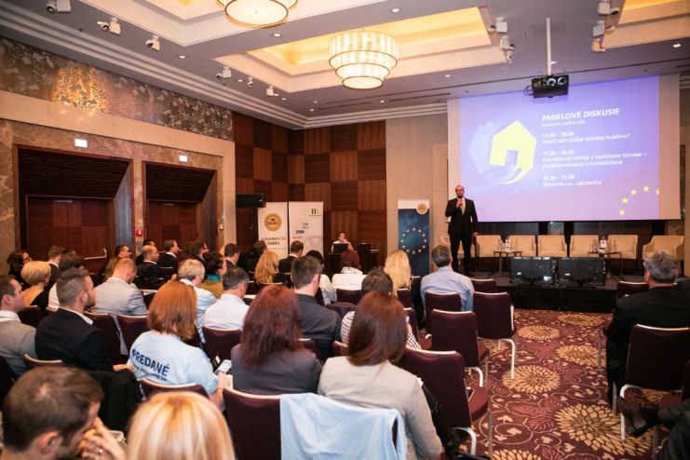
Field of study 3650 M Engineering
Management
3. and 4. year
Compulsory subjects :
Architecture, Civil engineering, Statics, Building mechanics, Economics, Land surveying, Budgeting, Thermo physics
Optional subjects:
Management, Estate a cadastre, Accounting

Slide 8
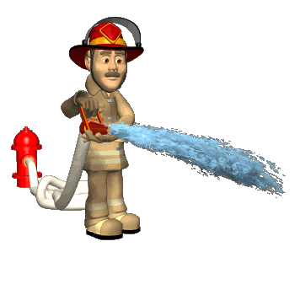
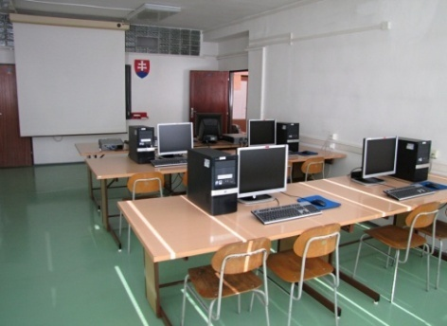
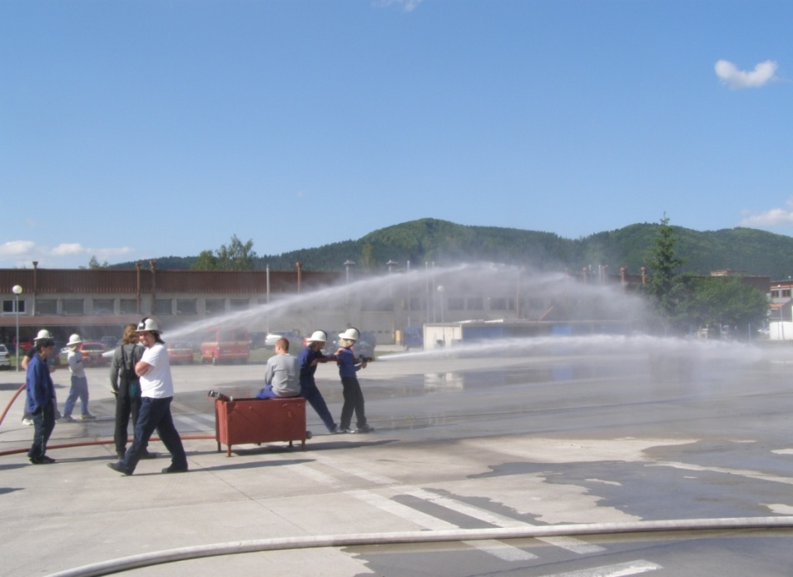
Field of study 3650 M Engineering
Fire prevention
3. and 4.year
Compulsory subjects :
Economics, Civil engineering, Architecture, Statics, Budgeting, Thermo physics, Constructions practice
Optional subjects:
Chemistry, Practice, Fire prevention

Slide 9
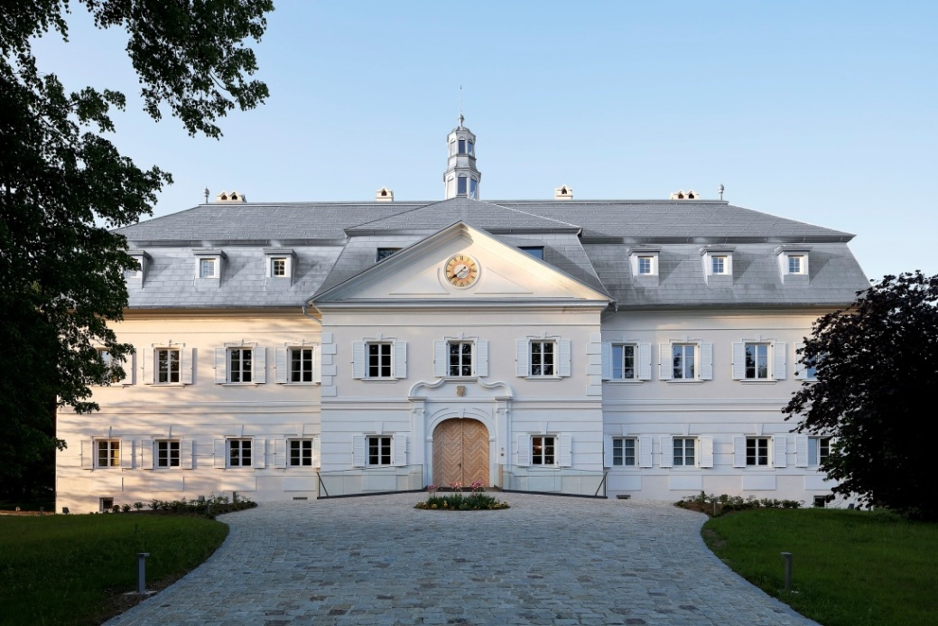
Field of study 3650 M Engineering
Reconstruction of buildings
3. and 4. year
Compulsory subjects: Civil engineering, Ekonomics, Constructions practice, Architecture, Statics, Budgeting
Optional subjects:
Reconstruction

Slide 10
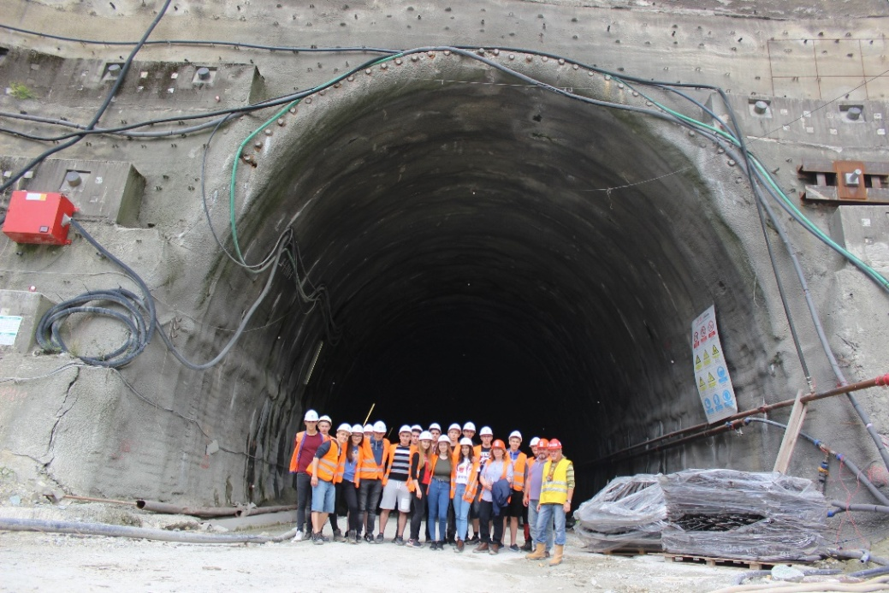
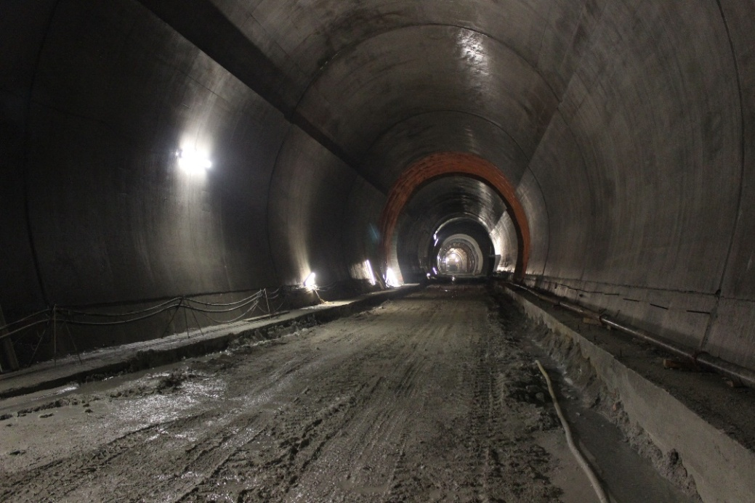
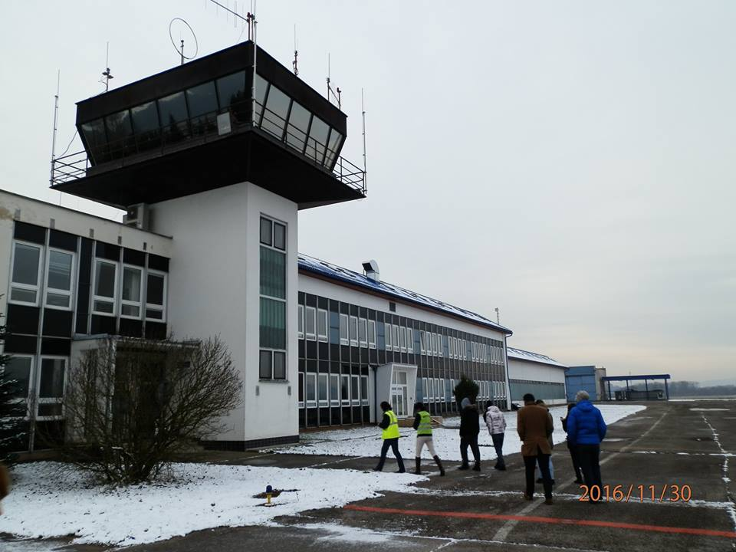
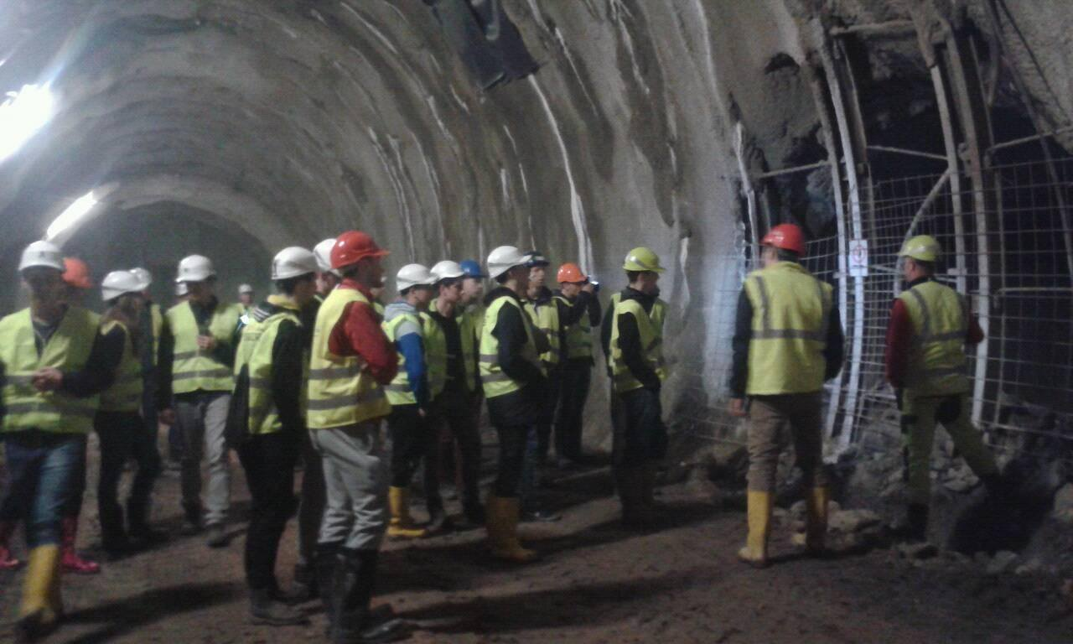
Field of study 3650 M Engineering
Road constructions
3. and 4. year
Compulsory subjects – Architecture, Statics, Building mechanics, Economics, Land surveying, Budgeting, Thermo physics
Optional subjects:
Road constructions, Bridges and tunnels, Water managements structures

Slide 11
Other activities
Field of study 3650 M Engineering
Competitions, SOČ (Secondary professional activity), Excursions, Vocational lectures, Conferences, Project days, Social activities – cinema, theater, concert, imatriculations, Activities of student parliament – St. Nicolas, Valentine´s Day, Sport activities – ski courses, tournaments, swimming courses, hiking.....

Slide 12
Field of study 3650 M Engineering
4. year – Maturita examination
Practical part
Theoretical part
3 - 4 days
25 tasks of Civil engineering + optional subjects
2 days
- First day – Building constructions
- Second day – Statics, Budgeting, CAD systems, Thermo physics....

Slide 13
THANKS FOR ATTENTION
☺
Ing. Dagmar Vankušová
Ing. Beáta Brisučiaková

